Slide 1
A Chinese Traditional Poetry Analyzing System Based on Deep Learning
Reporter: YAN JIAHUAN, LIANG ZIJIAN, LI QINYUAN
Report Date: 27-Apr-2023

Slide 2
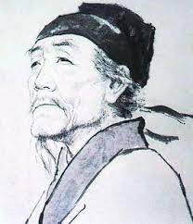
Background
“会当凌绝顶，一览众山小”
Once you get through this,
you can get through every challenge
Once you climbed to the mountain top of Tai,
Then I know all others are just hills
Task: How to help Chinese culture/poetry lovers Understand the meaning of poetry from bottom to
Top.
Once you climbed to the mountain top,
Then I know all others are just hills
Can be 凌 绝 top, one look many hill small
“xxxxx，xxxxx”

Slide 3




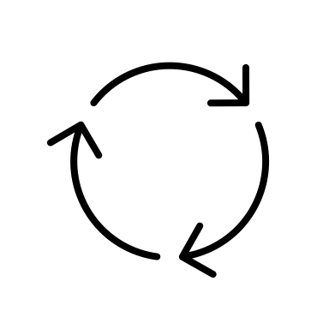



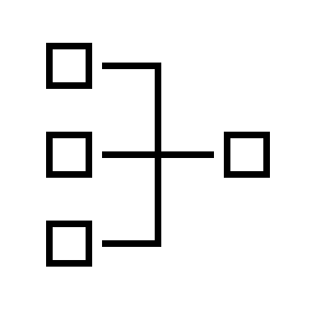
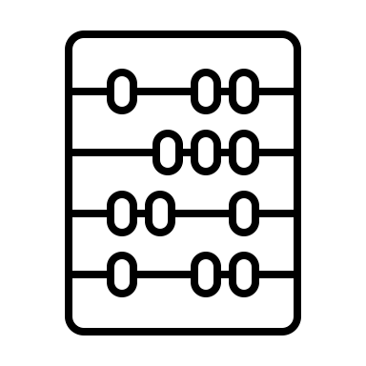
Outline
Step 1
Pre-training/Domain adaption based on poetry data and whole-word masking
Step 2
Transfer deploying based on ancient Chinese Translation models.
Step 3
Allusion recognition and explaining
The dataset has over 29,000 Chines ancient poetries. We randomly choose 2,900(10%) and cover all the dynasties.
The poetry and ancient Chinese are both structured words and somewhat similar
Find/extract the allusion from poetry
Collect Poetry data
Down stream task
Allusion matching
Use the encoder from self-trained Bert based on poetry dataset will unsure the better decoder ability
Use ChatGPT to explain the allusion we extracted
Some of the poetry is too long, over 256 tokens, and will be truncated to 256.
Data cleaning
GPT2
API
Use whole-word-masking to do MLM pretraining task on Bert-Chinese-uncased
Domain Adaption
Poetry explaining
Complete System
One for Two
Bert-poetry-wwm

Slide 4
Whole Word Masking - Poetry
Mask language modeling
Whole word masking
“The S in ISS stands for study plus study.”
“The S in IS##S stands for study plus study.”
“The”, “S”, “in”, “IS”, “S” ,”stands” ,
”for” ,”study”, “plus” ,“study.”
“The”, “S”, “in”, “IS”, “##S” ,”stands” ,
”for” ,”study”, “plus” ,“study.”
“The”, “S”, “in”, [MASK], “S” ,”stands” ,
”for” ,”study”, “plus” ,“study.”
“The”, “S”, “in”, [MASK], “##S” ,”stands” ,
”for” ,”study”, “plus” ,“study.”
Model Prediction Target
“The”, “S”, “in”, [MASK], [MASK] ,”stands” ,
”for” ,”study”, “plus” ,“study.”

Slide 5


Whole Word Masking - Poetry
“庄”,”生”,”晓”,”梦”,”迷”,”蝴”,”蝶“….
“庄”,”[MASK]”,”晓”,”梦”,”迷”,”[MASK]”,”蝶“….
- The word meaning has been segmented
Tokenizer/Model
“庄生晓梦迷蝴蝶”
“庄生”, ”晓梦”, ”迷”, ”蝴蝶”…
“庄生”, ”晓梦”, ”迷”, ”[MASK]”,”[MASK]”…
LTP
- The word meaning has been reserved
Link to dos of LTP
HIT

Slide 6
Pre-Training
Data set: 2,900 poetries(10%of the total poetry dataset)
MLM ratio: 15%
Masking strategy: Use “[MASK]” to replace “XXX”
Truncation: True
Initial Lr: 2e-5
Max Length: 128/256
Vocab size: 21128
Batch: 1/2/4
Epoch: 5/10/50
Time cost: 30-50 min/epoch
Loss: Cross-entropy loss
Metric: Loss

Slide 7
Some Visualized demonstrations
 | DRCD EM/F1 | CJRC EM/F1 | XNLI Accuracy | ChnSentiCorp Accuracy
Bert | 82.2/89.2 | 55.1/75.2 | 77.8 | 95.0
Bert-wwm | 82.8/89.7 | 55.1/75.4 | 78.2 | 95.4
* These are some Chinese NLP tasks.
* Thanks to Dr. Cui, this comparison data is from him and his colleagues.

Slide 8
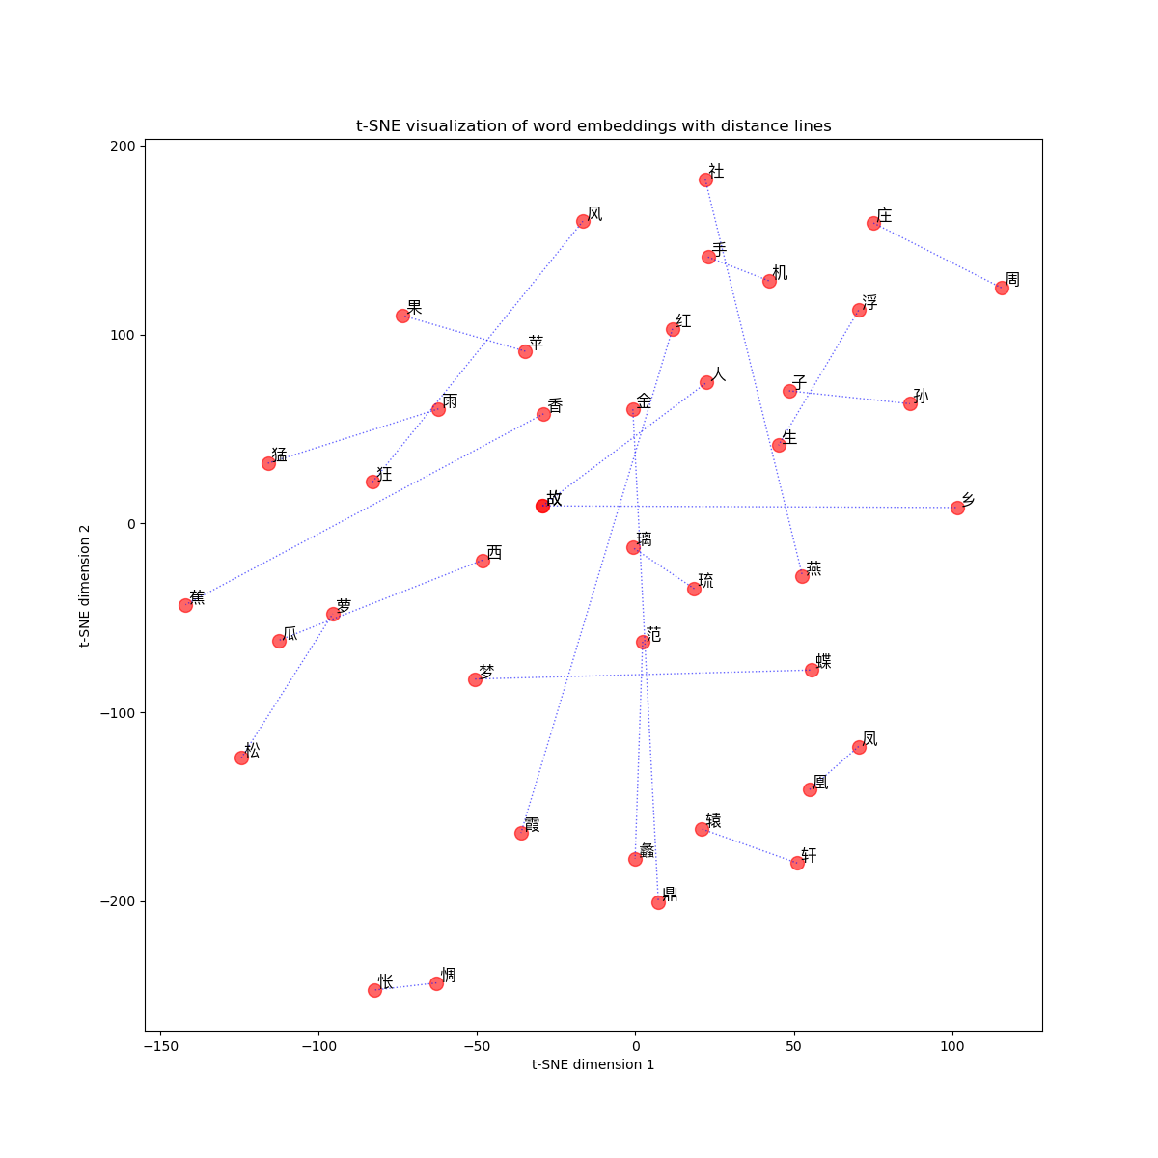
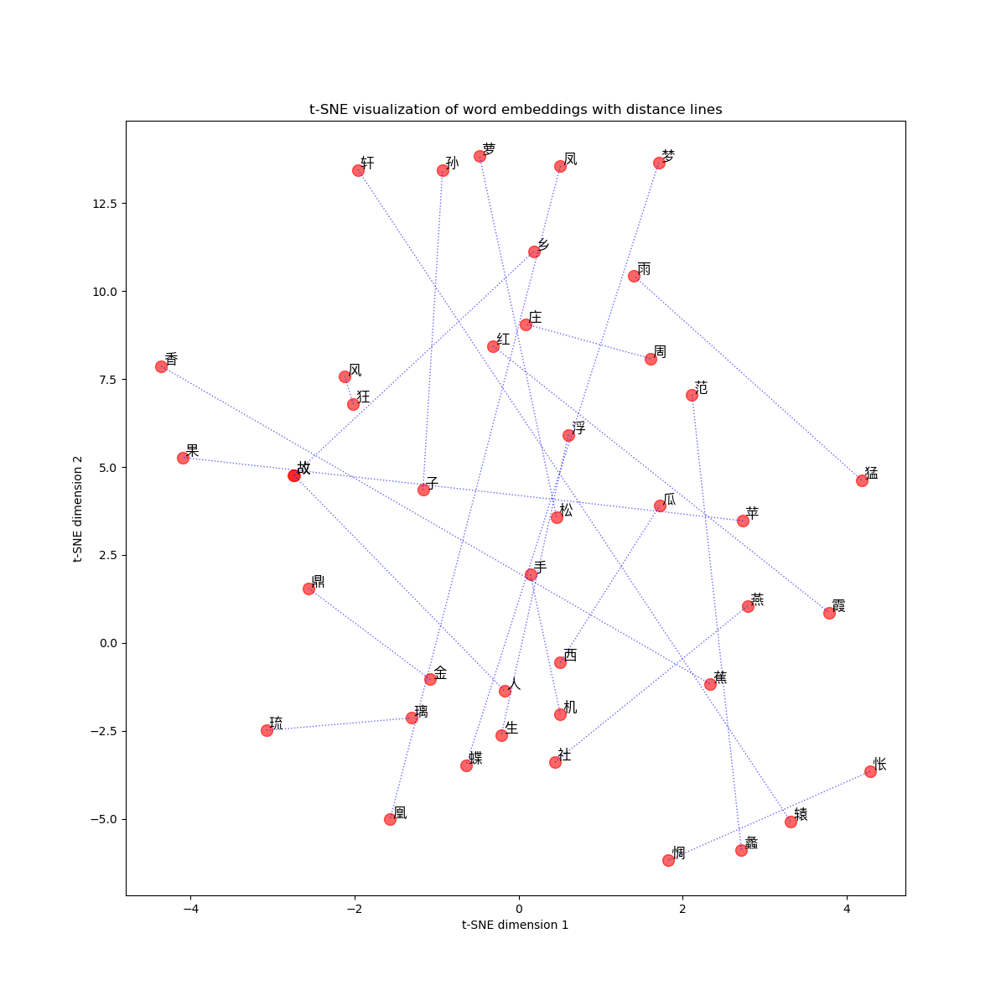
Some Visualized demonstrations
Bert
+ CN Wikipedia+ MLM/NSP
Bert-base-Chinese
+ 2,900 poetries + WWM
-Distance gets longer in words that are unusual in poetries.
-Distance gets shorter in words picked from poetries.
- T-SNE[Link to it]

Slide 9

Domain Adaption
BertforMaskedLM
BertfModel
bert.embeddings.position_ids
bert.embeddings.position_ids
Word.embeddings.weight
Word.embeddings.weight
For
downstream
task
layer.0.attention.self.query.weight
layer.0.attention.self.query.weight
Other Layers(weight,bias…)
layer.11.output.LayerNorm.bias
layer.11.output.LayerNorm.bias
cls.predictions.bias
We only need word representation ability of Bert after pre-training, but we don’t want to do same task (token guessing).
cls.predictions.decoder.bias
Layers for ML Task (classification format)

Slide 10
Ancient Chinese Translation model
Sequence to Sequence
Encoder
Decoder
Self-Trained-Bert-Poetry
GPT-2-Chinese-Poem
AutoTokenizer ( Self-Trained-Bert-Poetry )
AutoTokenizer ( Self-Trained-Bert-Poetry )

Slide 11
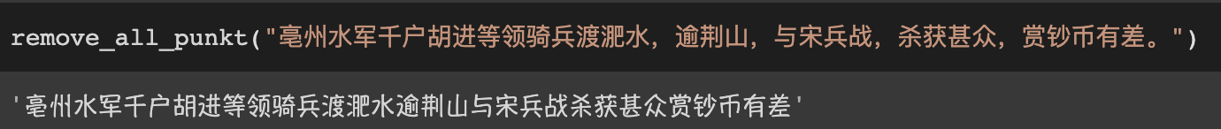
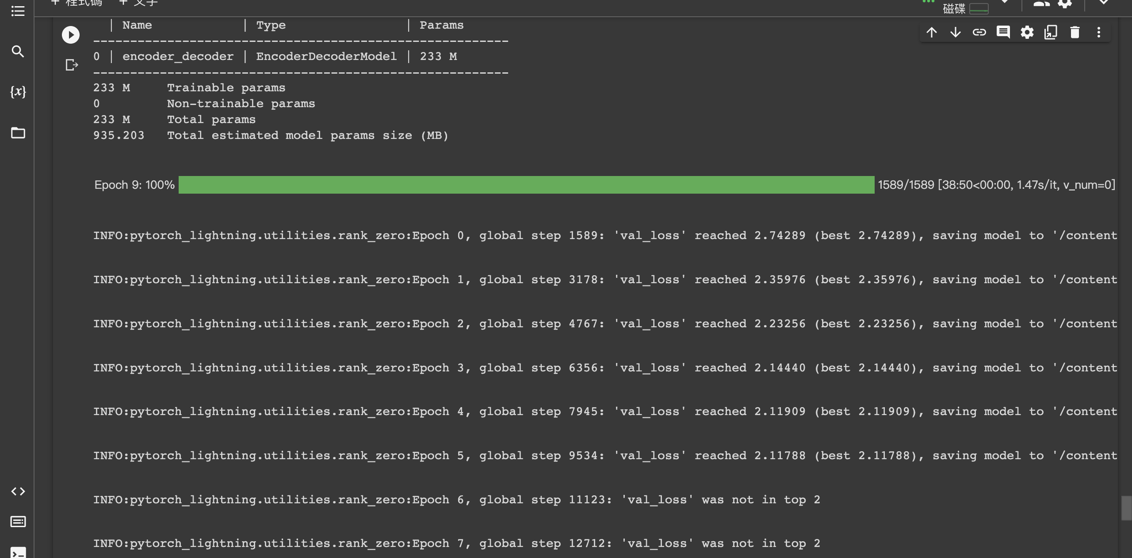
Data and Training
50%
Training Data
50%
4*V100
Ubuntu
Pytorch-lightning

Slide 12
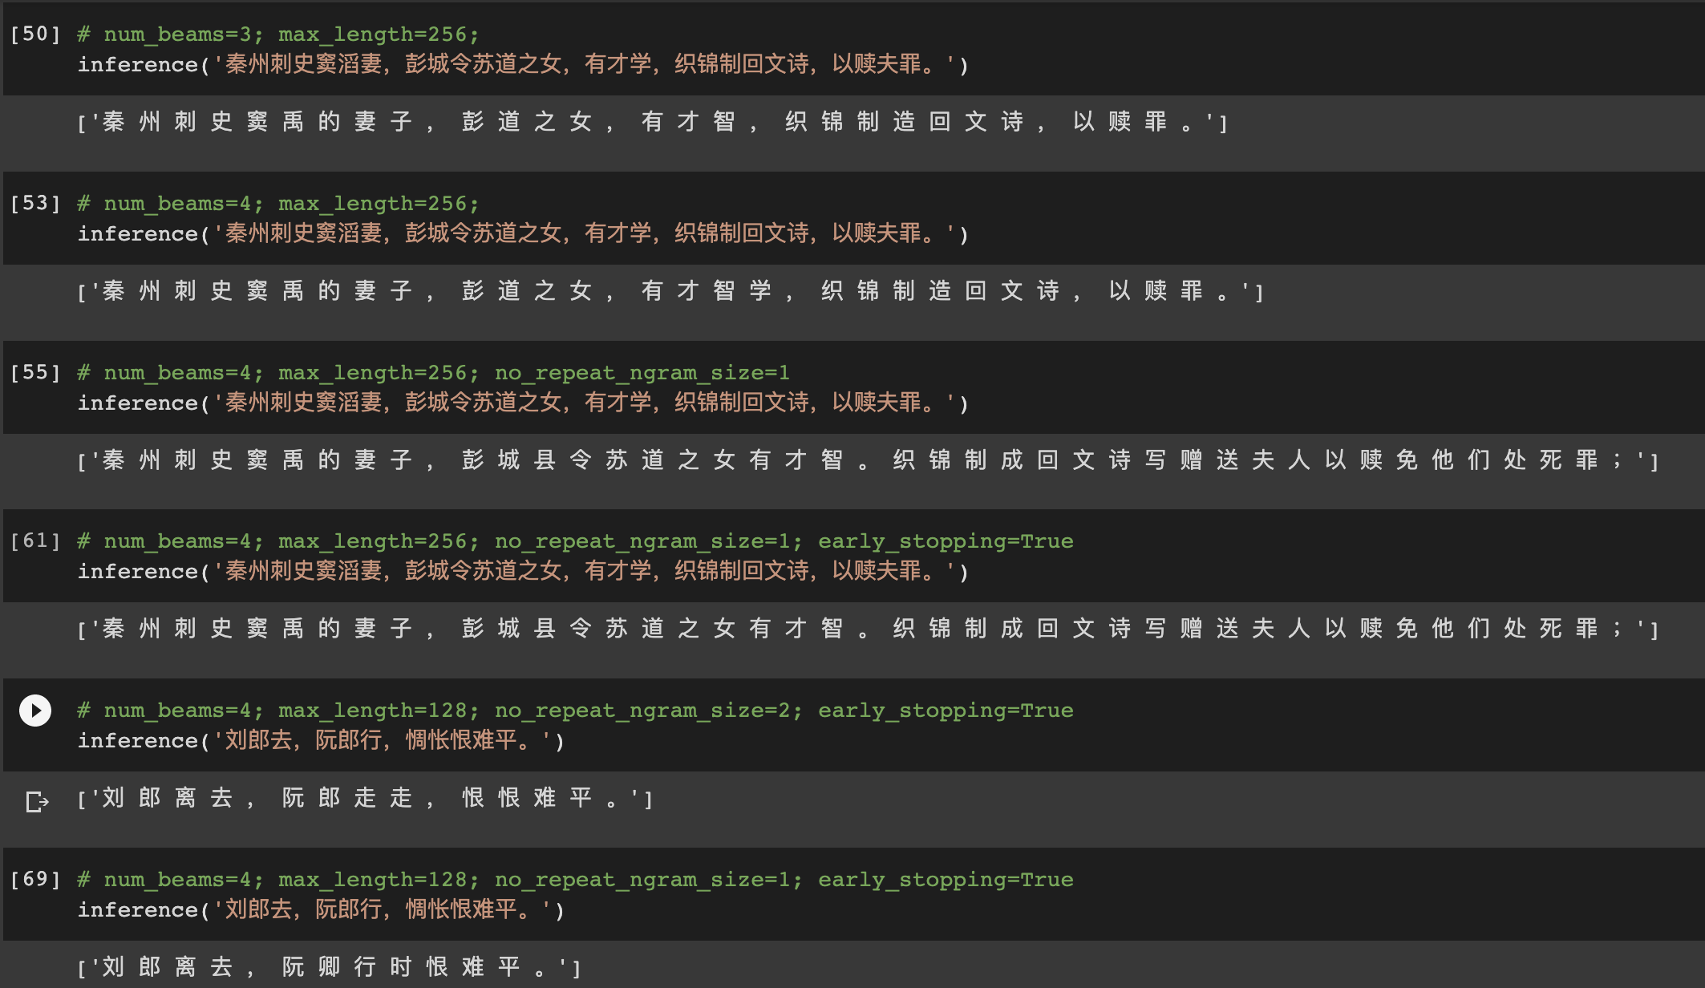

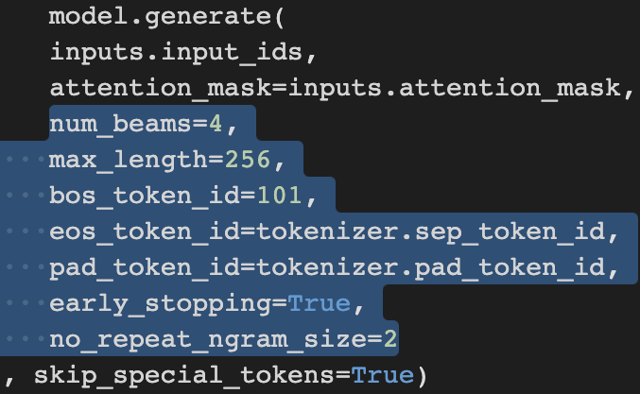
Hyper-Parameters
Result that use model from epoch 5

Slide 13
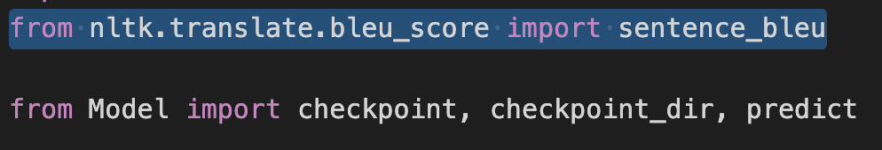
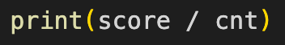
Evaluation - BLEU
Score on Training Dataset
Score on Testing Dataset
Score on Poem
Score on Lyrics
Score on Poem
Score on Lyrics

Slide 14
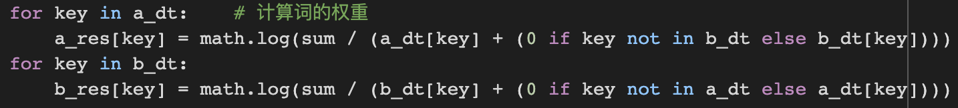
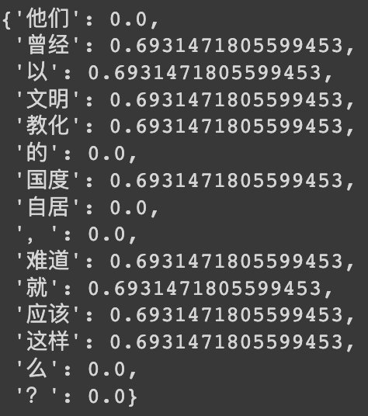
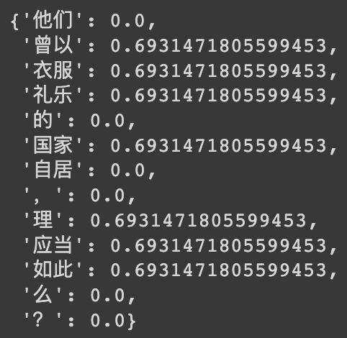
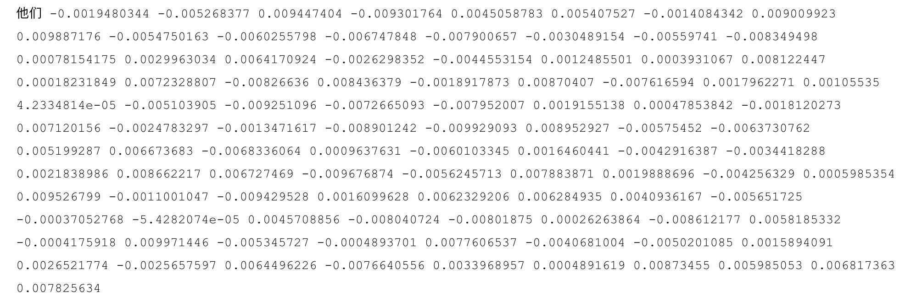
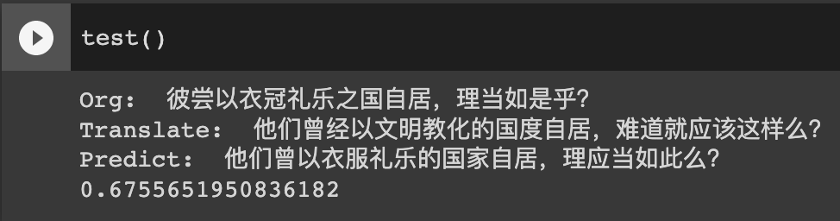
Similarities
Translate: 他们曾经以文明教化的国度自居，难道就应该这样么？ Predict: 他们曾以衣服礼乐的国家自居，理应当如此么？
1. TF-IDF - Match Score
2. Word2Vec - Cosine
Translate
Predict

Slide 15
Allusion recognition
Allusion：
Words with extended meanings quoted in poems
Refers to characters or events that are educational and familiar to the public
“梦蝶”
释义：
也称“化蝶”。战国时庄子有一次做梦，梦见自已变成了蝴蝶。后比喻做梦、梦幻。后人用来借指迷惑的梦幻和变化无常的事物。
例句：
庄生晓梦迷蝴蝶，望帝春心托杜鹃。（[唐]李商隐《无题》）

Slide 16
Allusion recognition
Relative work：
1. Rule-based allusion recognition
→ Unable to recognize allusions with indirect quotes.
2. Natural language-based method for identifying classical Chinese entities
→ Unable to distinguish allusions from general poem entities.
Our Method:
Calculate the sentence similarity between the target poem and the candidate allusion
√ Distinguish between entities and allusions
√ Identify allusion quoted indirectly

Slide 17
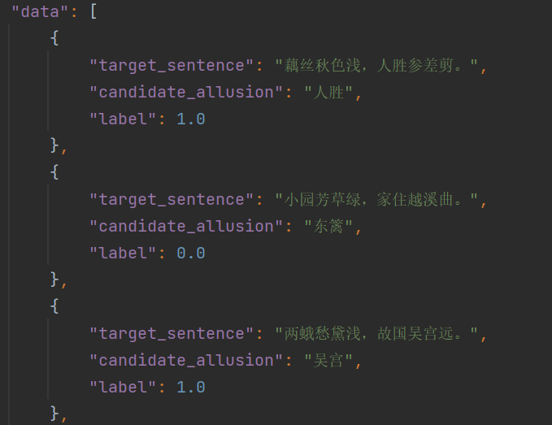
Allusion recognition
BERT-wwm-poetry
(Upstream work based on Chinese-focused classical BERT pre-training model)
Task: Improve the accuracy of allusions and ancient poetry sentence similarity
Dataset:
(demo)

Slide 18
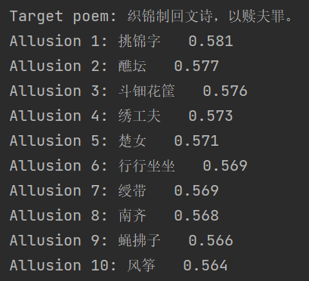
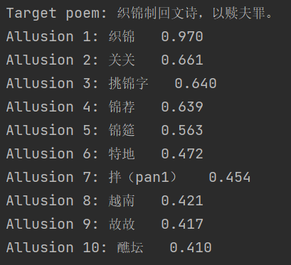
Allusion recognition
Comparison of model results
related
correct
related
other model
(based on base-wwm-chinese)
bert-allusion
(based on our upstream work)

Slide 19
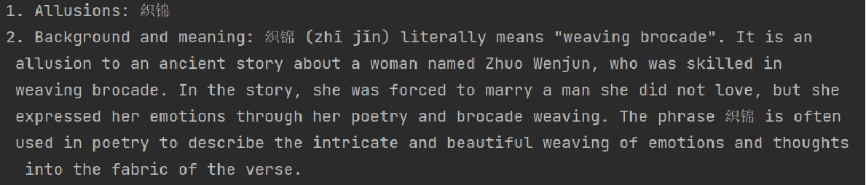
Allusion explaining
GPT-API
Model: GPT-3.5-turbo
Input: The allusion with the highest sentence similarity.
Background information: Definition of allusion.
Output: allusion explanation

Slide 20
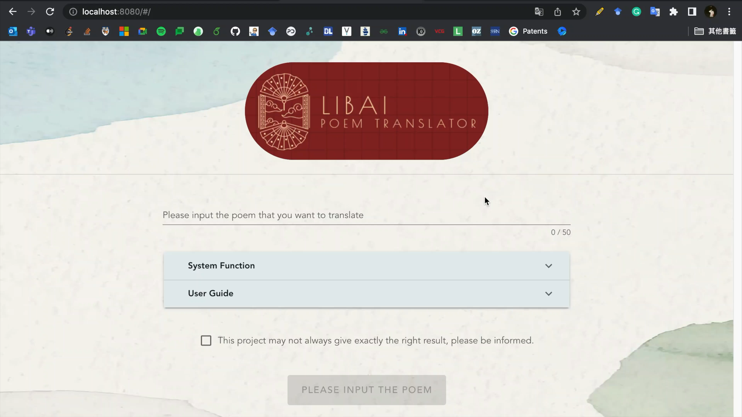
Demo

Slide 21
Future work
Use the complete dataset for pre-training
Use Mac(Masking as correction) strategy for whole word masking
Dataset emerging (part1,2,3 use same/overlapped dataset)
Integrate allusion explaining into text translation
Thank you for your attention!

